Slide 1

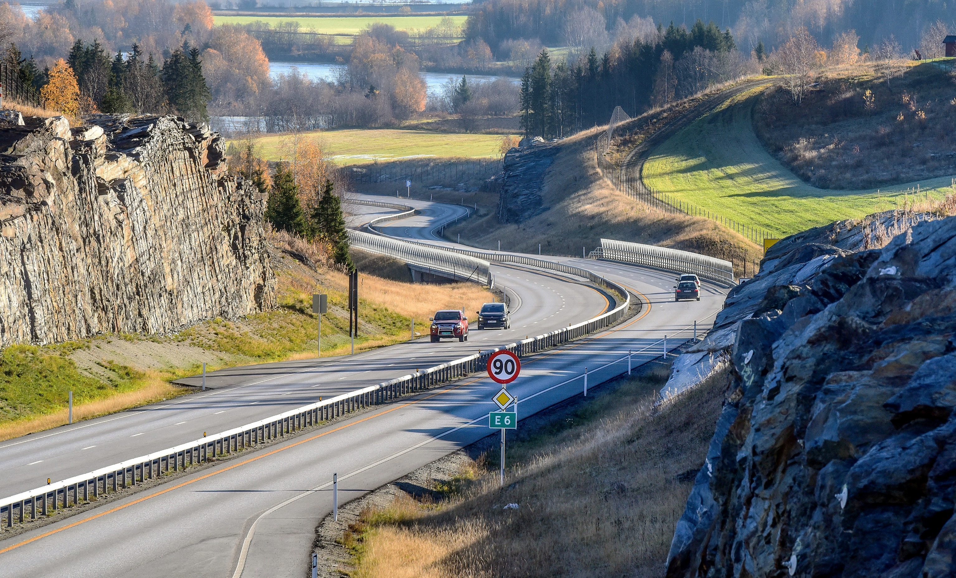

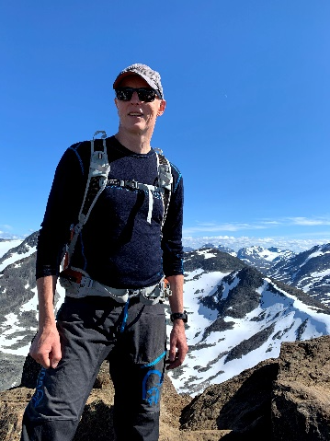
Ontologier – kobling GIS-BIM-ITS Technologies for information modelling in Geographic Information Systems (GIS), Intelligent Transport Systems (ITS) and Building Information Modelling (BIM)
Knut Jetlund
Kartverket
Norges teknisk-vitenskaplige universitet
ISO/TC 211 AG5 - HMMG
knut.jetlund@kartverket.no
LinkedIn: https://www.linkedin.com/in/knut-jetlund/
Photo: Knut Opeide, Statens vegvesen

Slide 2
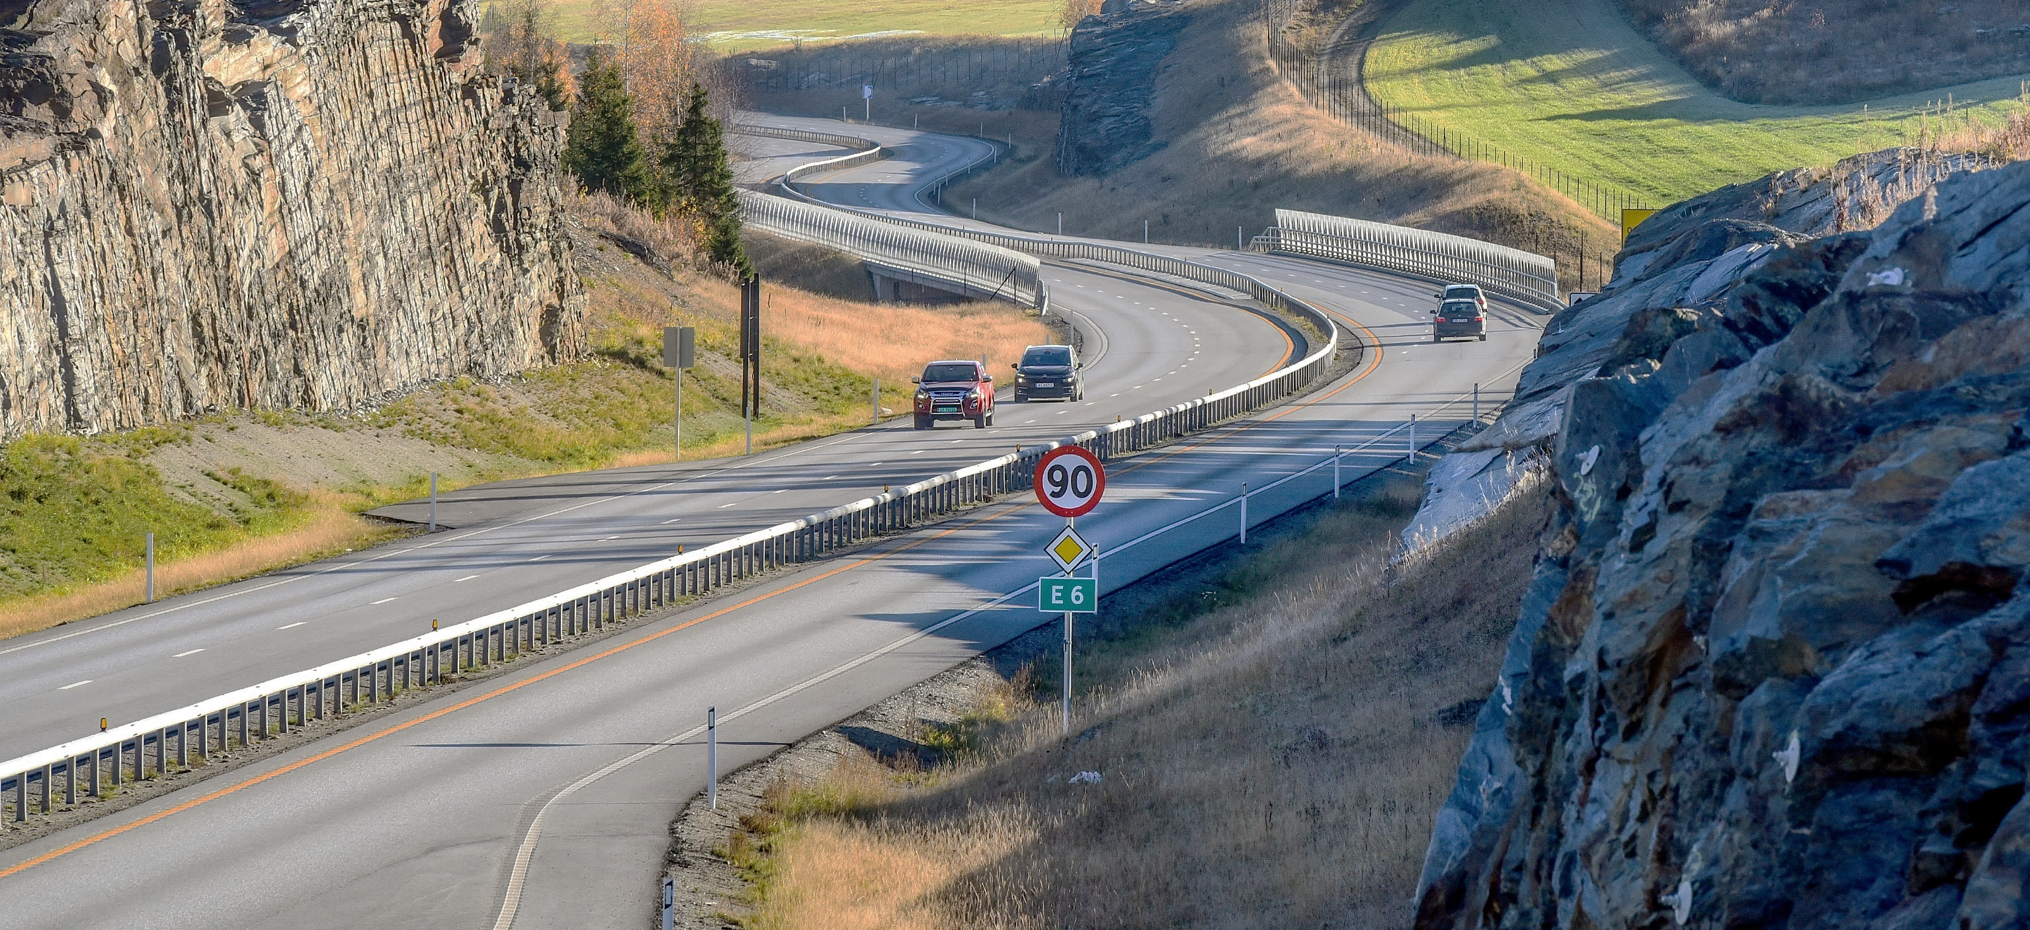
Three application domains, one real world
Photo: Knut Opeide, Statens vegvesen
Notes:
Constructions in the real world, such as features in the road infrastructure in this picture, relate to, influence and are influenced by, other features from the natural and built environment, through their location, shape and extent.
This geospatial context is vital for the representation of the natural and built environment in a digital environment as well.
During the lifecycle of the road, processes involve several application domains where the geospatial context is essential. Among these are the application domains of GIS, ITS and BIM. The three application domains have distinct, but related, roles, and handle the real world from different perspectives: Applications for GIS are mostly used for analyzing and presenting the existing natural and built environment, while applications for BIM are used for planning, developing, constructing and maintaining the built environment. Finally, applications and systems for ITS use the information about the built environment to plan and control transportation.
The three application domains work with the same physical geospatial environment, but due to the different roles, they have different views on the real world and its representation in a digital geospatial environment.

Slide 3
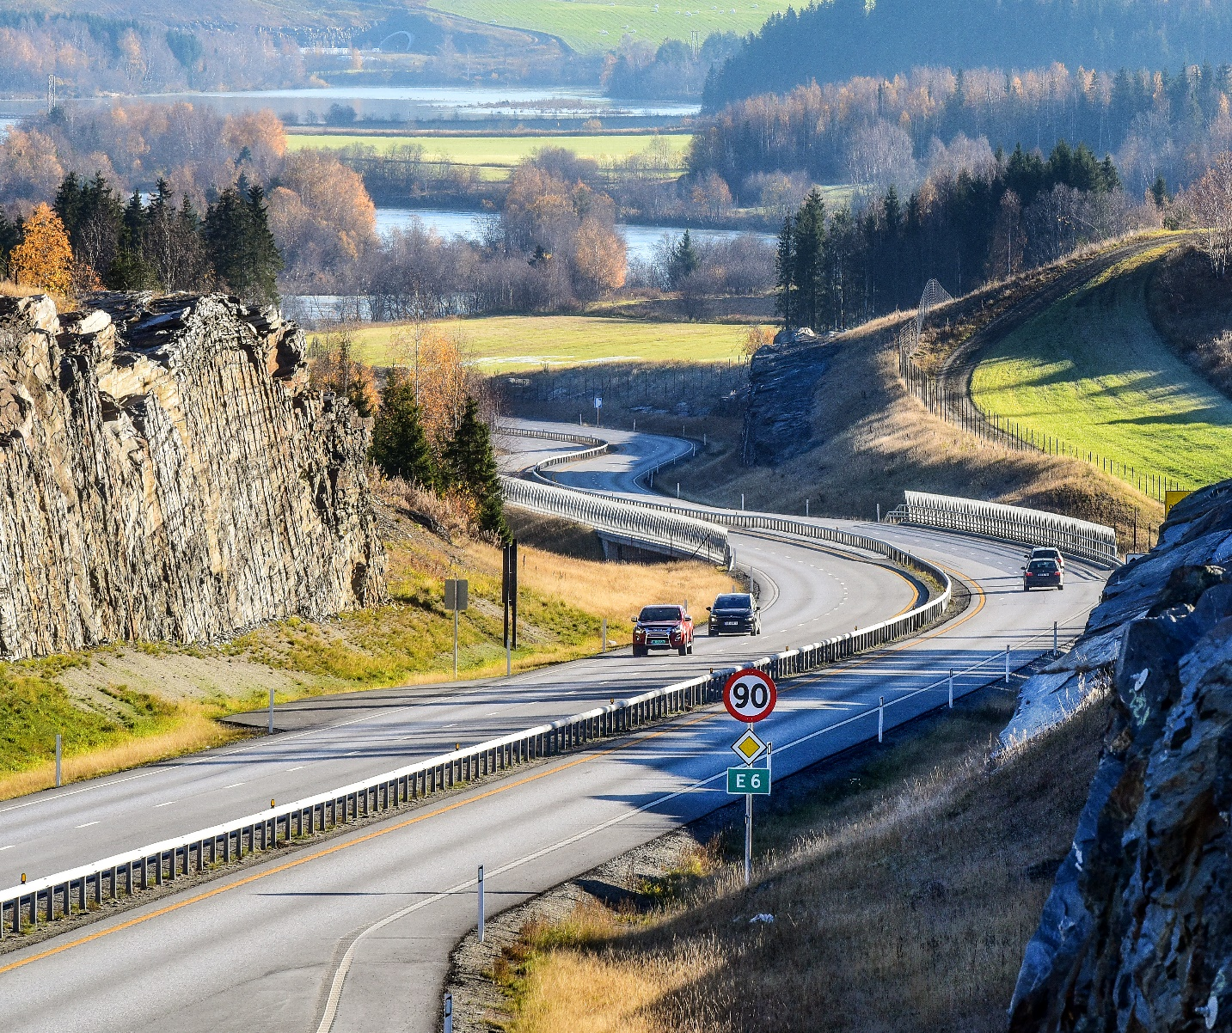
Reuse of information across domain borders
The challenge:
Reuse requires a common understanding of how the real world is described in information models
Modelling language
Terminology
Geometry and location referencing
Exchange technologies
Photo: Knut Opeide, Statens vegvesen
Notes:
While the roles of GIS, ITS and BIM are distinct, and the application domains see the real world from different perspectives, the picture shows us that many of the real-world features and concepts they handle are the same. Therefore, reuse of information across application domain borders should be possible.
Before this road was built, there was mostly a natural environment, represented in GIS data sets. The new road was planned, developed and constructed with support from BIM processes. During the construction, the road cut into and changed the existing natural and built environment and became an integrated part of a new physical environment. Therefore, the GIS data sets need to be updated with the new built environment, as well as the changed natural environment. Also, ITS applications for route planning and navigation need an updated representation of the road environment, and of restrictions for navigation, such as speed limits and forbidden manoeuvres.
Let’s use the railings in this picture as an example: The digital representation of a guardrail along a new road will begin its life in the planning stage for the road, where the railing is created in a BIM application, as a feature that shall be constructed. The feature representation of the railing should later be reused in GIS datasets, for presentation on maps, and, for example, for calculating noise pollution. Furthermore, the same railing is needed in High Definition maps for ITS as an obstacle that vehicles need to be aware of. The different domains need specific information about the feature, but they are all referring to the same real-world phenomenon.
The challenge we face in the exchange and reuse of information is that the different application domains have developed information models with their specific interpretation of the real world. In order to understand information across domain borders, we need a common understanding of how the real world is described in information models. This concerns the modelling languages that are used, the terminology, how geometry and location references are described, and the exchange technologies that are used.

Slide 4
DIKW - Data, Information, Knowledge and Wisdom
The DIKW Hierarchy. Adapted from (Rowley, 2007).
Notes:
The hierarchy of Data, Information, Knowledge and Wisdom has been described as a pyramid, where data is at the lower level, followed by information and knowledge, and wisdom at the pinnacle. Each level of the hierarchy, starting from the top, relies on the level below: wisdom is gained from knowledge; knowledge is gained from information; information is gained from data.
Data are simple symbols. For example, the numbers «90» or «2».
Information is data put into context, where it has a meaning. For example, the speed limit 90 km/h or outdoors temperature 2 degrees Celcius.
Knowledge is gained by combining information. For example, a vehicle can know that it is allowed to drive at 90 km/h according to the speed limit, but also that it should reduce the speed due to possible challenging conditions because the outdoors temperature is 2 degrees.
The final level, wisdom, has been described as a purely human state. With wisdom, we are able to plan for the future and apply knowledge to new situations.

Slide 5
Information models and ontologies
Information model
“… a formal description of types of ideas, facts and processes which together form a model of a portion of interest of the real world and which provides an explicit set of interpretation rules.” (Schenck and Wilson, 1994).
“… a representation of concepts, relationships, constraints, rules, and operations to specify data semantics for a chosen domain of discourse” (Zhao et al., 2011)
≈ Ontology
“… a set of precise descriptive statements about some part of the world (usually referred to as the domain of interest or the subject matter of the ontology)” (Hitzler et al., 2012)
“… a common vocabulary for researchers who need to share information in a domain. It includes machine-interpretable definitions of basic concepts in the domain and relations among them”. (Noy and McGuinness, 2001)
Vocabulary
“terminological dictionary that contains designations and definitions from one or more domains or subjects”.
Rules to understand data in a context
Implements the concepts in a modelling language
Defines the concepts
Notes:
Information models are the interpretation rules needed to extract information from data. My thesis was based on an understanding of the term information models from Schenk and Wilson in 1994: “… a formal description of types of ideas, facts and processes which together form a model of a portion of interest of the real world and which provides an explicit set of interpretation rules.”
A similar definition was described by Zhao et al in 2011: “… a representation of concepts, relationships, constraints, rules, and operations to specify data semantics for a chosen domain of discourse”.

Slide 6
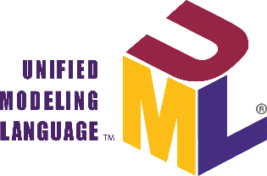

Information modelling
From the real world to conceptual models.
Jetlund, K. (2021). Harmonizing and linking conceptual models of geospatial information. Faculty of Engineering, Department of Manufacturing and Civil Engineering, Norwegian University of Science and Technology. PhD: 207.
Notes:
The definitions in the previous slide mentioned “a portion of interest” and “a domain of discourse”. These terms are an important fundament for the process of information modelling. Obviously, one single model cannot describe every concept from the real world in every context, we need to define some portion that we are interested in, such as a road network, buildings or utilities.
This figure, which is adapted from ISO 19101, describes the process of information modelling, where the first step is to select a portion of interest from the fuzzy cloud we know as the real world and perceive it in a context. The portion of interest is often referred to as a universe of discourse.
The universe of discourse will be defined in a conceptual model, but in order to create a formal description, we need some kind of formalism. For this, we need a conceptual schema language, which can describe the model in a conceptual schema. Two such conceptual schema languages are the Unified Modelling Language, UML, and the Web Ontology Language, OWL.

Slide 7
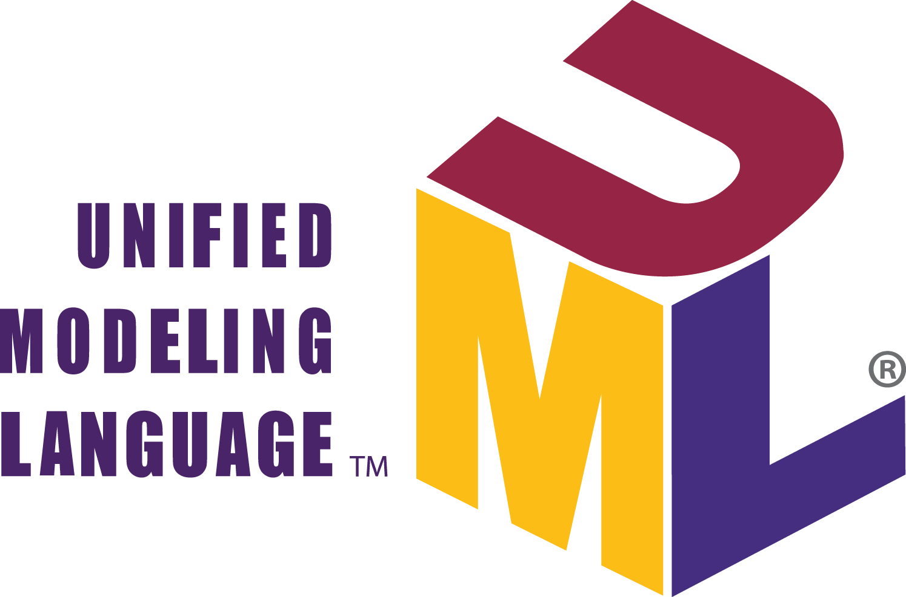
Interoperability
ISO/IEC 2382:2015 :“capability to communicate, execute programs, or transfer data among various functional units in a manner that requires the user to have little or no knowledge of the unique characteristics of those units”.
Same meaning:
What is a guardrail?
Same syntax: UML, EXPRESS, XML, OWL
Notes:
ISO/IEC 2382:2015 (ISO/IEC JTC 1,
2015) has defined interoperability as “capability to communicate, execute programs, or transfer
data among various functional units in a manner that requires the user to have little or no
knowledge of the unique characteristics of those units”.
The levels of conceptual interoperability has been discussed by many researchers, ranging from no interoperability to full conceptual interoperability. The four core levels are… Additional levels for dynamic and conceptual

Slide 8
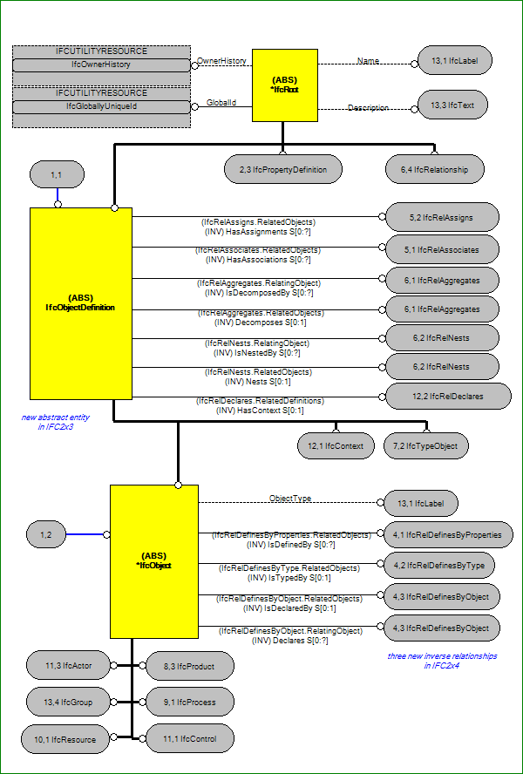
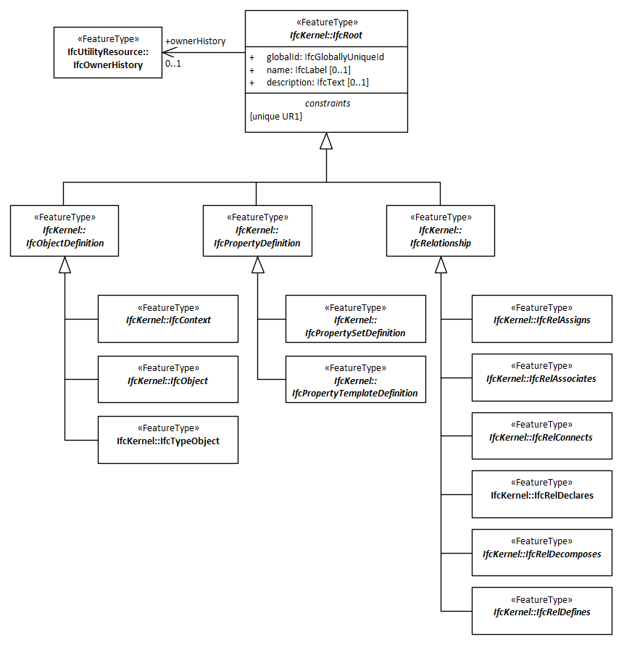
Syntactic interoperability
EXPRESS

Slide 9
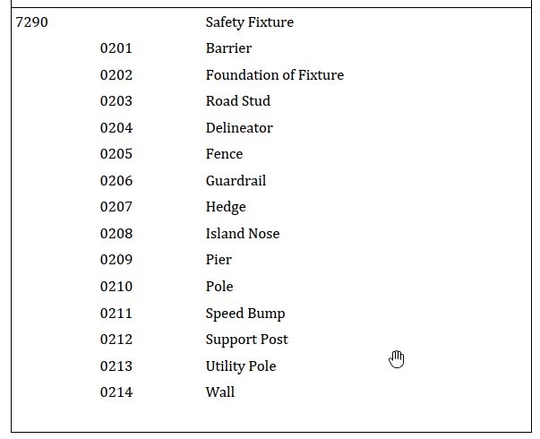
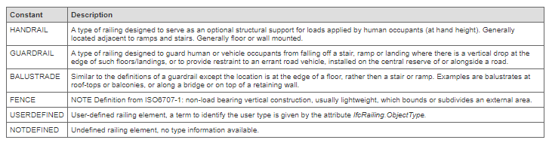
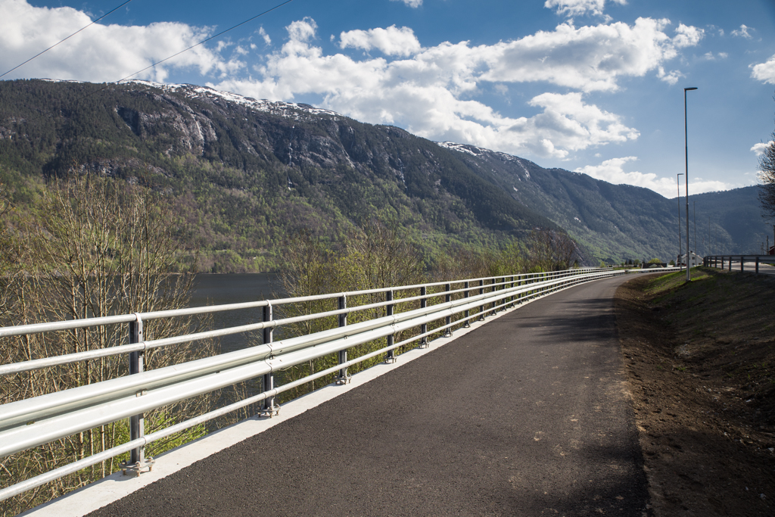
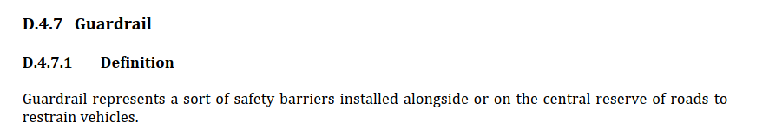
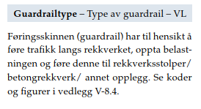
Semantic interoperability
GDF – Safety fixture
IFC - IfcRailingType
What is a guardrail?
V.440 – Railing with guardrail
Photo: Silje Drevdal / Statens vegvesen

Slide 10
How can we achieve a common understanding?
Research question:
“How can approaches and technologies for information modelling be applied for harmonization and linking of conceptual models of geospatial information from the three application domains of GIS, ITS and BIM?”
Jetlund, K. (2021). Harmonizing and linking conceptual models of geospatial information. Faculty of Engineering, Department of Manufacturing and Civil Engineering, Norwegian University of Science and Technology. PhD: 207.
Notes:
So, how can we achieve this common understanding?
This was the main research question for the thesis, formulated as: «How can approaches and technologies for information modelling be applied for harmonization and linking of conceptual models of geospatial information from the three application domains of GIS, ITS and BIM?”
As we have seen from the previous slides, the three application domains have different views on the real world. And, most likely, they will need to be different, as they use the digital representations in different ways and for different purposes. We need to acknowledge that a full harmonization of information models may not be appropriate. Therefore, the thesis studies harmonization, and linking, of heterogeneous models, as illustrated in the figure. We strive for a harmonization but acknowledge the need for linking in addition.

Slide 11
Jetlund, K. (2021). Harmonizing and linking conceptual models of geospatial information. Faculty of Engineering, Department of Manufacturing and Civil Engineering, Norwegian University of Science and Technology. PhD: 207.
Notes:
The main research question was supported by five sub research questions, which in sum were intended to cover information modelling in the three application domains, the roles they have in the digital geospatial environment, and the relations between them.
The questions were addressed through five published articles and a conference proceeding, as well as through contributions to other relevant work in international standardization.
As shown in the figure, there were relations between the sub research questions: The first question established the fundament for addressing the four others, and question 4 depended on input from question 2, 3 and 5.

Slide 12
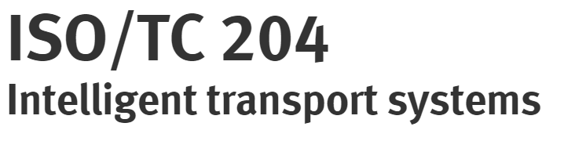

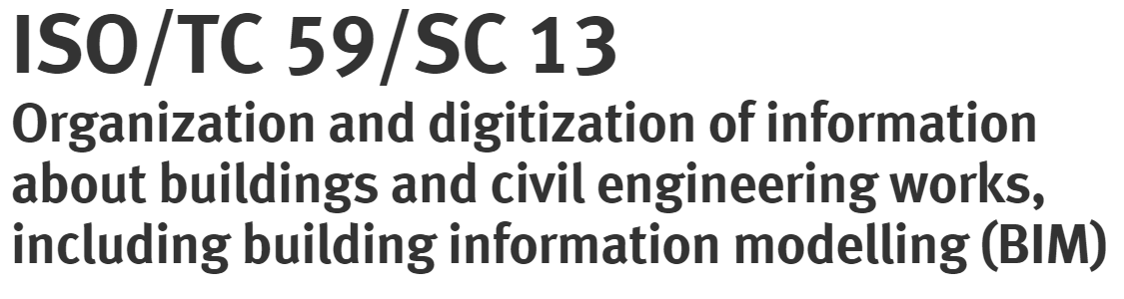


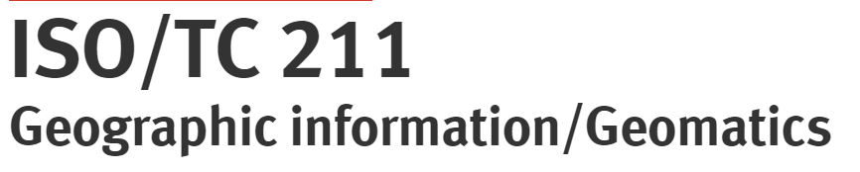
SRQ1: State of the art
“What approaches and technologies have been used for modelling geospatial information in GIS, ITS and BIM?”
All three application domains:
Conceptual schemas in UML
Some degree of MDA
UML and MDA for GIS is the most complete approach
But with defeciencies
Notes:
The state-of-the-art analysis showed that standards and specifications from all three application domains describe models of geospatial information, with various approaches and technologies.
A number of specifications exist in the ITS domain, but the ISO/TC 204 standard GDF has been identified as the primary official model for geospatial information. While the Navigation Data Standard is an essential industry standard. Other essential ITS standards are TPEG2 and DATEX II for dynamic information.
In the BIM domain, the core concepts for geospatial information are defined in the IFC specification, developed by buildingSMART and standardized by ISO/TC 59.
In the GIS domain, ISO/TC 211 and OGC have standardized the basic concepts for the use of MDA and UML in a range of standards, and organizations all over the world have developed domain models of geospatial information based on those standards.
A common denominator for all application domains was the use of UML as the conceptual schema language, and modelling approaches with some degree of MDA.
The information modelling approach in GIS as standardized by ISO/TC 211 was identified as the most structured and complete approach for modelling geospatial information.
The defined UML profiles, the MDA approach with specified levels of abstraction, modelling and conversion rules, and the modular structure, are advantages compared to approaches in the two other application domains. However, deficiencies were found in the GIS approach as well, by this research as well as others.
Therefore, the further research focused on the development of an improvement of the GIS approach, and the development of domain models according to the improved approach.

Slide 13

SRQ5: Ontologies for linking and mapping
“How can UML models of geospatial information be implemented as OWL Ontologies, for linking and mapping by applying Semantic Web technologies?”
Notes:
I will now move to sub research question five, and come back to number four later.
Sub research question five concerned the relationship between UML models and OWL ontologies, focusing on the use of OWL Ontologies for linking and mapping of heterogeneous models of geospatial information. As we remember from the illustration of the main research question, we acknowledged that the models could not be completely harmonized, and that additional linking and mapping would be necessary. Semantic web technologies such as OWL and SPARQL have been considered a valuable approach for this purpose.
In order to enable UML models for use in the Semantic Web, the UML models must be converted to OWL ontologies, and this conversion was the topic for the sub research question.

Slide 14
Fundamental differences
Closed World Assumption (CWA)
Open World Assumption (OWA)
Structure of information
- The class «Swan» with specific properties
Meaning of concepts
- A «Swan» is a subclass of the class «Bird», if specific properites with specific values are given
→ The derived ontologies tend to be a bit “UML-ish”
Notes:
The studies found that conversions from UML to OWL are possible, and have been described in ISO/TC 211 standards, OGC Testbeds, and in related research. However, some challenges were identified and were mainly related to fundamental differences between how UML and OWL describe the real world.
First, UML focuses on the structure of information, while OWL focuses on the meaning of concepts. In UML, we define, for example, that a feature is a Railing, and has specific properties, while another feature is a Fence and has its specific properties as well. While in OWL, we define that a thing that has some defined properties is a Railing, but it can also be a Fence at the same time. Which is more like we see it in the real world: The same feature may be a railing and a fence. Classification depends on the context.
Besides, properties in OWL so-called first-class individuals who exist on their own, while UML attributes and associations are uniquely owned by the individual class.
Furthermore, UML models are defined in a closed world assumption, where we assume that the model is complete in the given context. Information that does not fit the model will be invalid. Contrary, OWL is based on an open-world assumption, where anyone can say anything about any topic. The model represents only what is currently known in the given context and may be extended with additional information.
---
Due to these differences, UML models are more restricted, and representations of UML restrictions is a challenge for the conversion from UML to OWL.

Slide 15
Level of information flow
Conversions of restrictions from the CWA to the OWA must be configured according to the selected level of information flow:
Ontologies for use only in the Semantic Web
Unidirectional information exchange to the Semantic Web
Bidirectional information exchange
Notes:
The most essential observation from the sub research question was that the need for maintaining restrictions from UML in OWL will depend on the intended level of information flow for the resulting ontologies. We defined three levels of information flow:
Ontologies for use only in the Semantic Web, in which case restrictions and the original structure from the UML models can be disbanded.
Unidirectional information exchange from UML based models to the Semantic Web. As for the first level of information flow, few restrictions from the UML model are needed in the ontologies, as they will primarily be used for describing the information.
Bidirectional information exchange. For this purpose, the OWL ontologies and the original UML model should be as identical as possible. The information must be valid according to the UML models to make sure it can be imported into repositories defined by the UML models. Therefore, conversions need to maintain restrictions and the original structure as far as possible.
Model-driven conversions from UML to OWL need to consider the different levels of information flow and apply conversions appropriate for the selected level. Therefore, conversion rules, and software implementing the rules, need to be configurable.

Slide 16
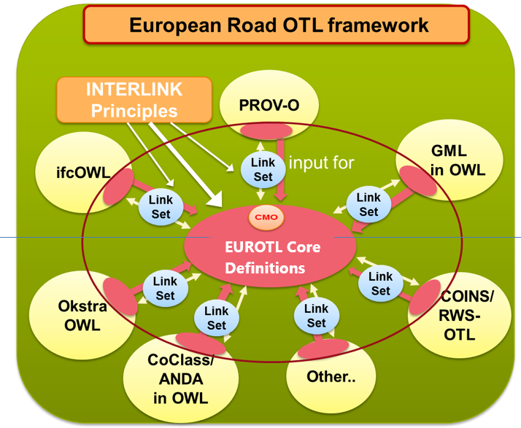
Linking and mapping information models
http://wpd1.s3.eu-central-1.amazonaws.com/index.html
Jetlund, K. (2021). Harmonizing and linking conceptual models of geospatial information. Faculty of Engineering, Department of Manufacturing and Civil Engineering, Norwegian University of Science and Technology. PhD: 207.

Slide 17
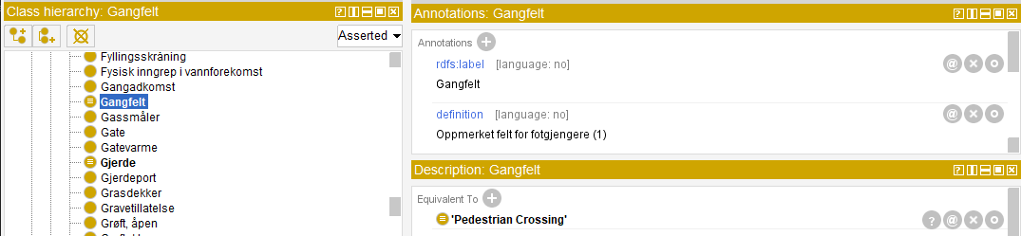
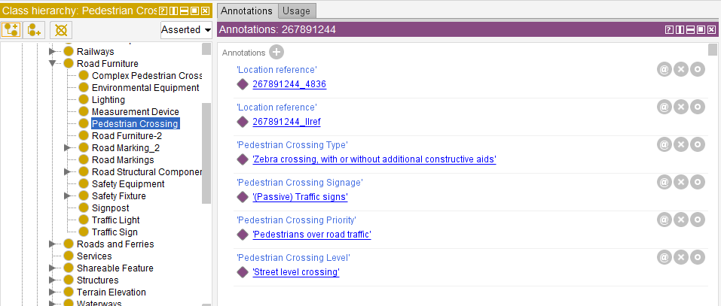
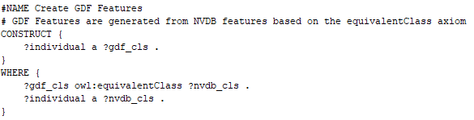
Example LinkSet: NVDB → GDF
NVDB
GDF
SPARQL
Result

Slide 18
Conclusions
Full harmonization not appropriate
Apply LinkSets for mapping
Apply a joint modelling approach for all three domains
Use common core concepts
Data types from non-domain-specific models
Common concepts for geometry and location referencing
Photo: Knut Opeide, Statens vegvesen
Notes:
The research indicated that a full harmonization would not be the best solution for optimized use in each application domain. The three application domains have different roles in the digital geospatial environment and need to describe features from the real world in different contexts, with different representations.
Therefore, further improvements of the semantic interoperability must be achieved by applying Linksets based on Semantic Web technologies for linking and mapping of heterogeneous information models. For this purpose, the research showed that conversions from UML to OWL could be improved, but must be configured according to the level of information flow.
Even though the models cannot be wholly harmonized, they should be as harmonized as possible. Any transformation leads to a loss of information, and models that are based on the same modelling approach and use the same core concepts are more similar, and fewer transformations are needed.
Therefore, the joint modelling approach should be applied, and common, core concepts should be used as far as possible. In particular, general concepts for core datatypes should be used in all domains, and common concepts for geometry and location referencing should be established and used.

Slide 19
Summary
Many digital representations
Ecosystem of digital twins
Open and Closed World Assumptions
Pros and cons – depending on the use case
Syntactic interoperability by translation
Neither UML nor OWL is perfect
Semantic interoperability is more complicated
Modular standards based on an MDA are fit for implementation i various domains and technologies
Use common models as far as possible!

Slide 20
Similar representations
Tobler’s first law of geography (Tobler, 1970):
“everything is related to everything else, but near things are more related than distant things”.
Modernized to a digital world with multiple representations of the same physical ”thing”:
“every digital representation of a thing can be linked to any other digital representation of the same thing, but links between similar representations are more precise than links between dissimilar representations”.
Jetlund, K. (2021). Harmonizing and linking conceptual models of geospatial information. Faculty of Engineering, Department of Manufacturing and Civil Engineering, Norwegian University of Science and Technology. PhD: 207.
Notes:
52 years ago, the geographer Waldo R Tobler defined his first law of geography as
“everything is related to everything else, but near things are more related than distant things”.
Following the conclusions from the previous slide, Tobler’s first law can be modernized into a digital world with multiple representations of real-world things, saying that
“every digital representation of a thing can be linked to any other digital representation of the same thing, but links between similar representations are more precise than links between dissimilar representations”.
In other words; we should strive towards digital representations that are as similar as possible.

Slide 21
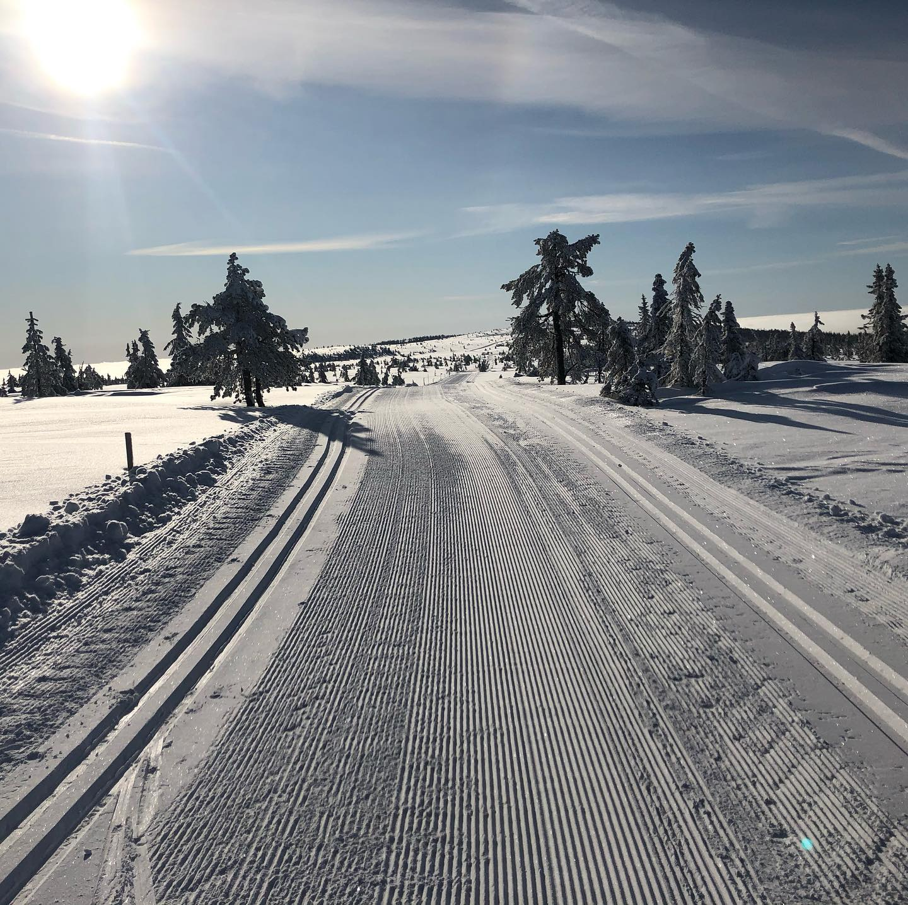
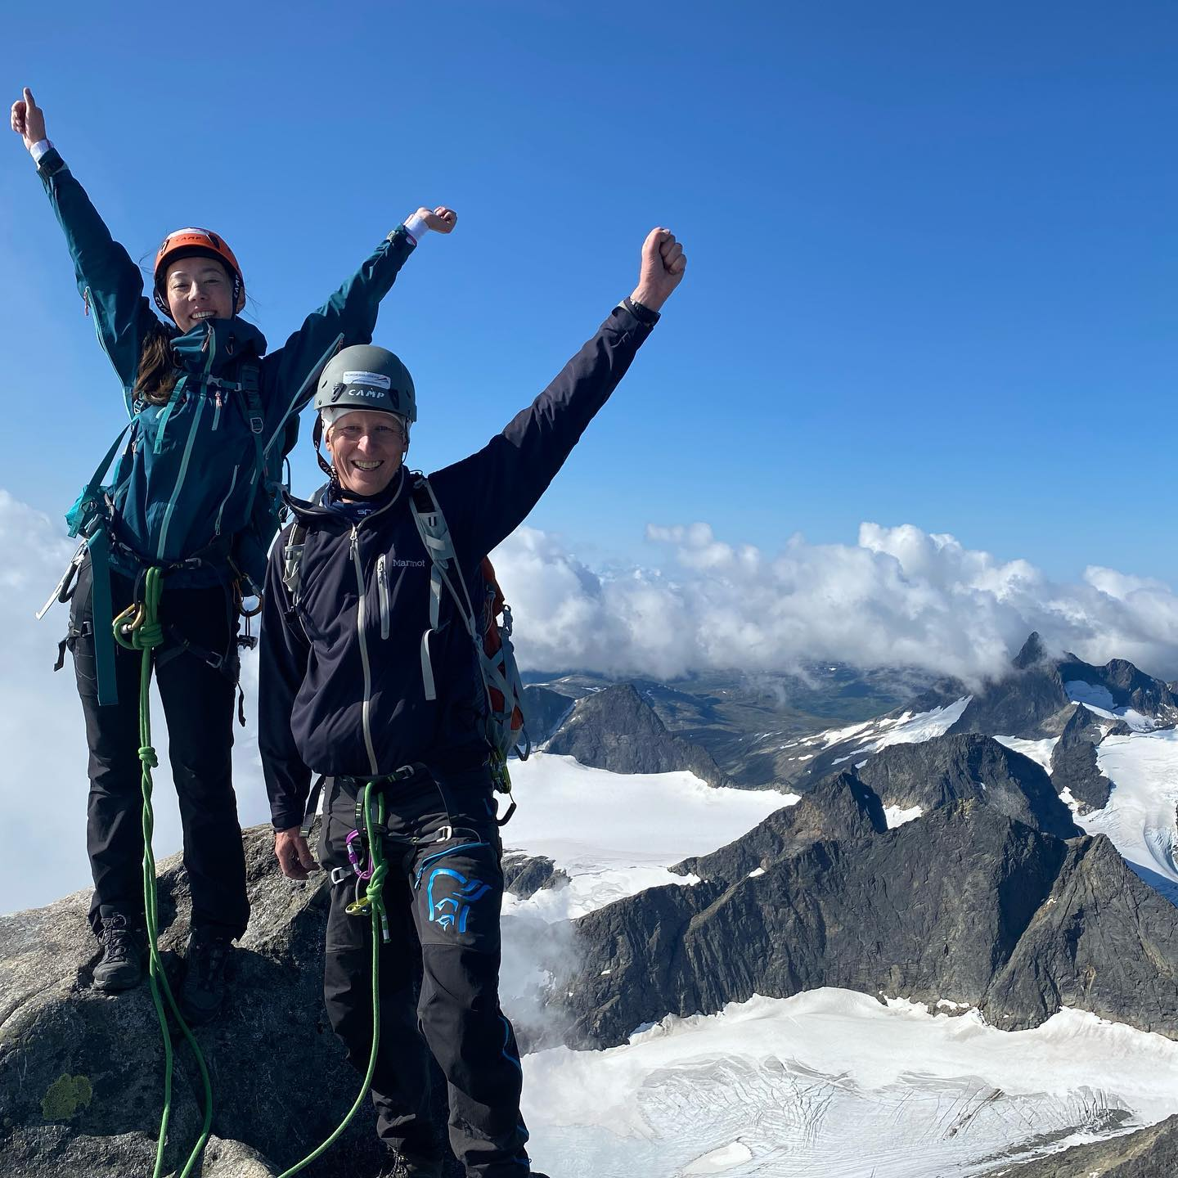
Thanks for listening!
Knut Jetlund
Norwegian Mapping Authority
Norwegian University of Science and Technology
ISO/TC 211 AG 5 – HMMG
knut.jetlund@kartverket.no
LinkedIn: https://www.linkedin.com/in/knut-jetlund/

